Slide 1
Oramorph Audit
By Zoë Gregory and Josie Shipman

Slide 2
Plan
NICE guidance around Oramorph prescription
Method of Data Collection
Methods to Improve Oramorph Prescriptions
Data Presentation

Slide 3
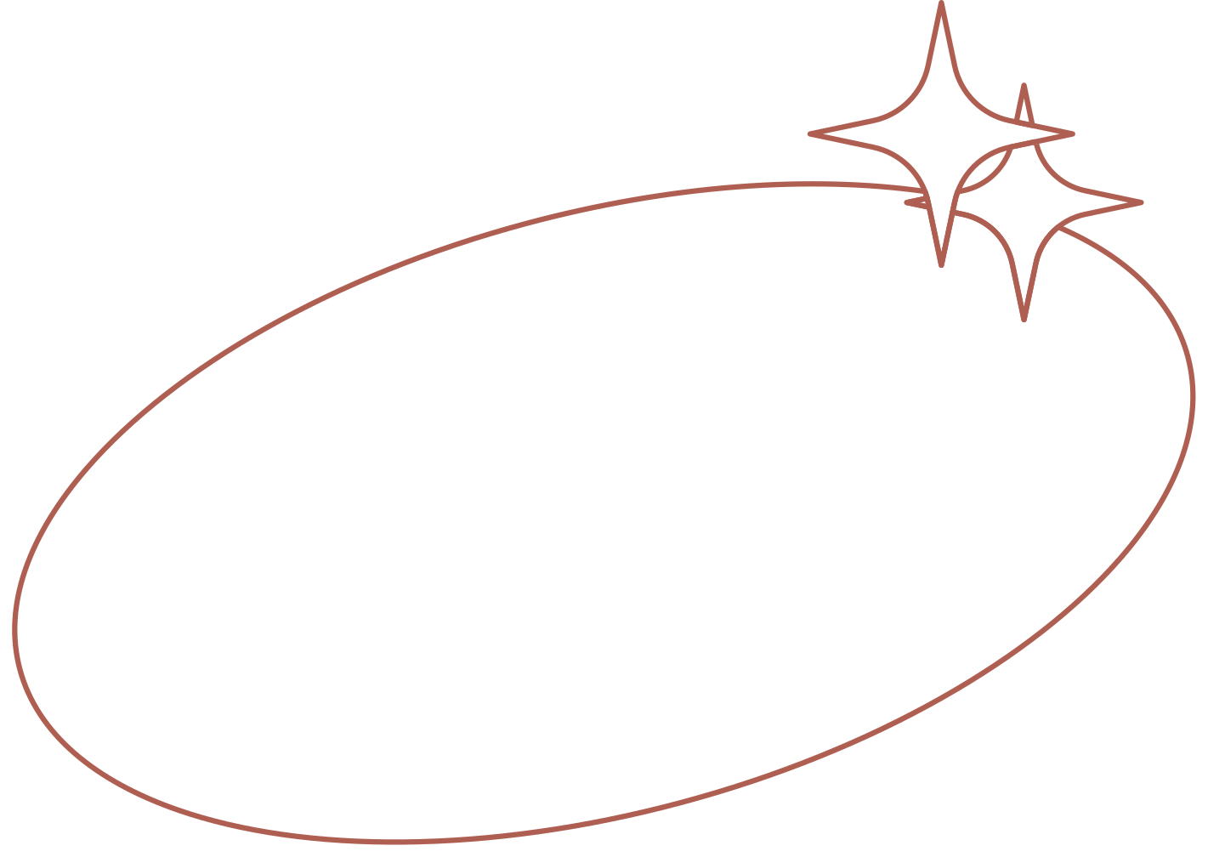
NICE Guidance

Slide 4
Guidance on prescribing controlled drugs
When prescribing controlled drugs:
document clearly the indication and regimen for the controlled drug in the person’s care record
check the person’s current clinical needs and, if appropriate, adjust the dose until a good balance is achieved between benefits and harms
discuss with the person the arrangements for reviewing and monitoring treatment
be prepared to discuss the prescribing decision with other health professionals if further information is requested about the prescription.
Document and give information to the person taking the controlled drug or the carer administering it, including:
how long the person is expected to use the drug
how long it will take to work
what it has been prescribed for
how to use controlled drugs when sustained-release and immediate-release formulations are prescribed together

Slide 5
Guidance on prescribing controlled drugs
Prescribe enough of a controlled drug to meet the person’s clinical needs for no more than 30 days. If, under exceptional circumstances, a larger quantity is prescribed, the reasons for this should be documented in the person’s care record.
When prescribing a repeat prescription of a controlled drug for treating a long-term condition in primary care, take into account the controlled drug and the person’s individual circumstances to determine the frequency of review for further repeat prescriptions.

Slide 6
BNF Indications for Prescribing Morphine
Acute pain
Chronic pain
Pain management in palliative care
Cough in palliative care
Myocardial infarction
Acute pulmonary oedema
Dyspnoea at rest in palliative care

Slide 7
NICE Contraindications for Prescribing Morphine
Tension-type headaches
Migraines
Chronic sciatica
Acute and Chronic lower back pain
Neuropathic Pain
Osteoarthritis

Slide 8
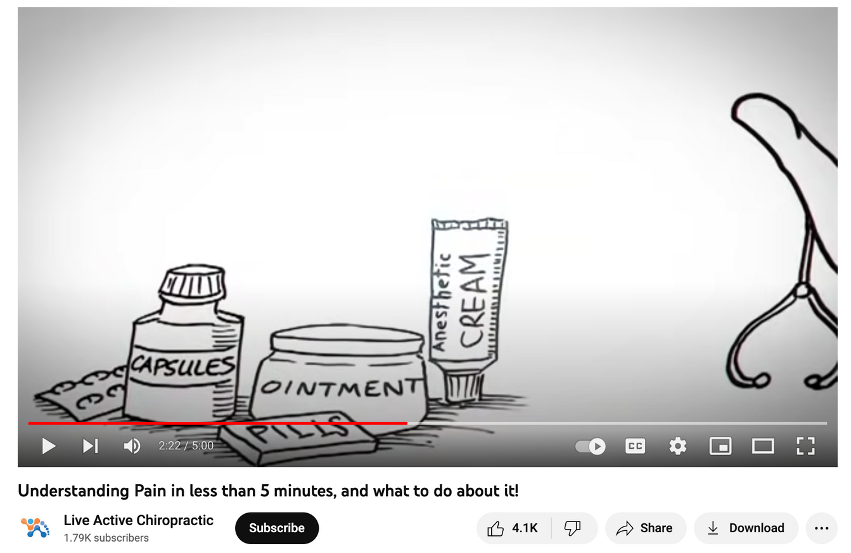
Chronic Pain
https://www.youtube.com/watch?v=C_3phB93rvI

Slide 9
Method of Data Collection

Slide 10
Data Collection
using EMIS
Participants: everyone on a repeat oramorph prescription who wasn't a palliative care patient - 98 participants
Looked at the prescription:
Is the amount of drug required specified in mg and ml?
Is the dose frequency specified?
Is the maximum daily dose specified?
Any errors in these three fields?
Are they on any other opioids?

Slide 11
Data Presentation

Slide 12
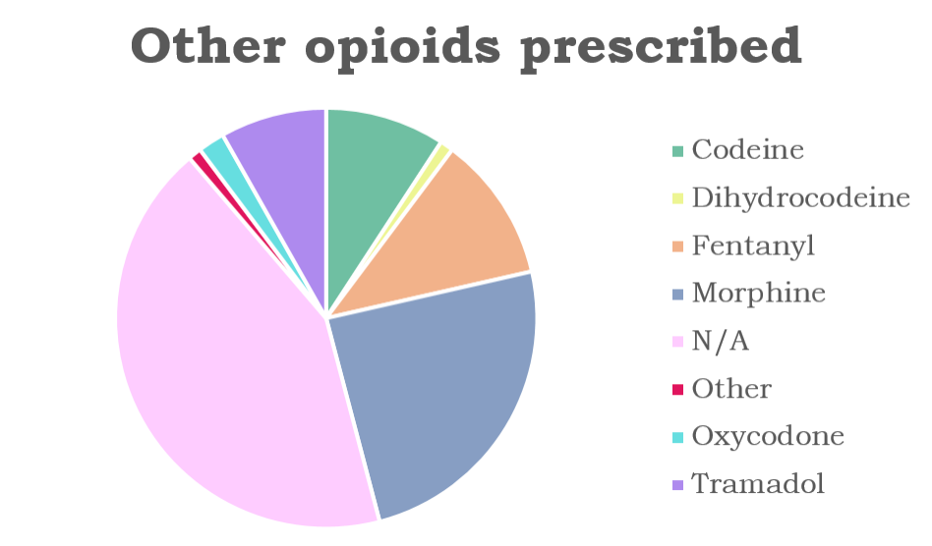
Other Opioids Prescribed

Slide 13
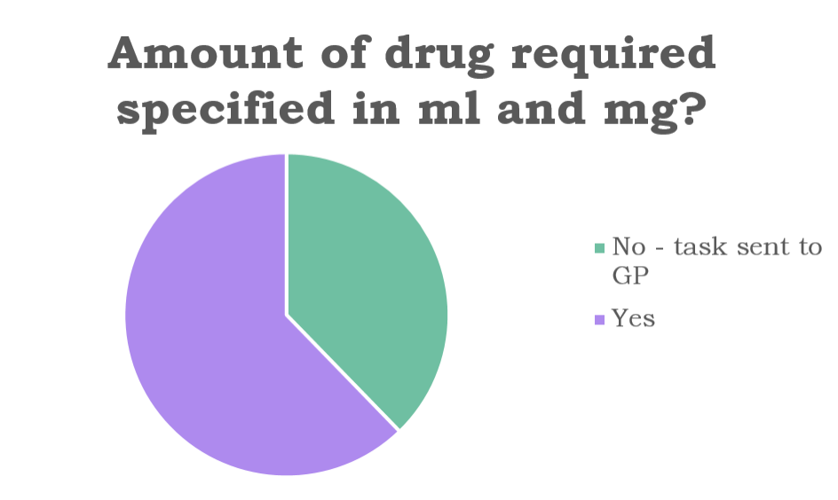
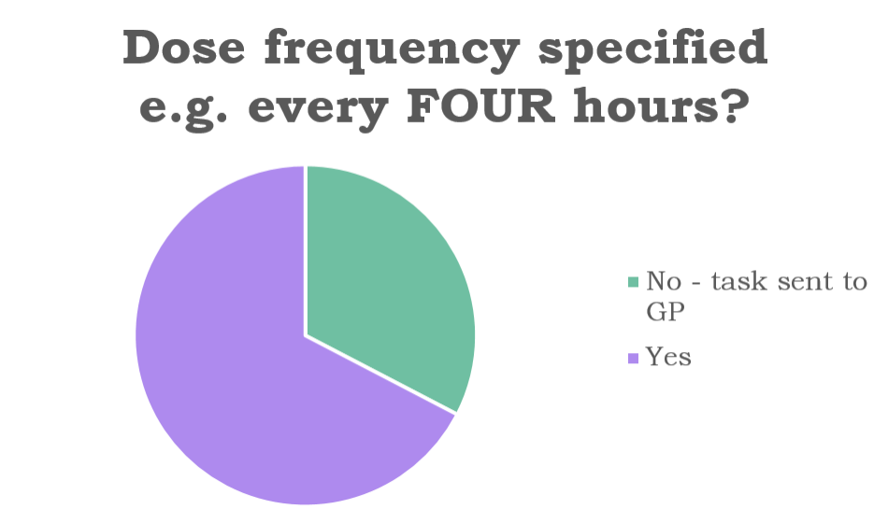
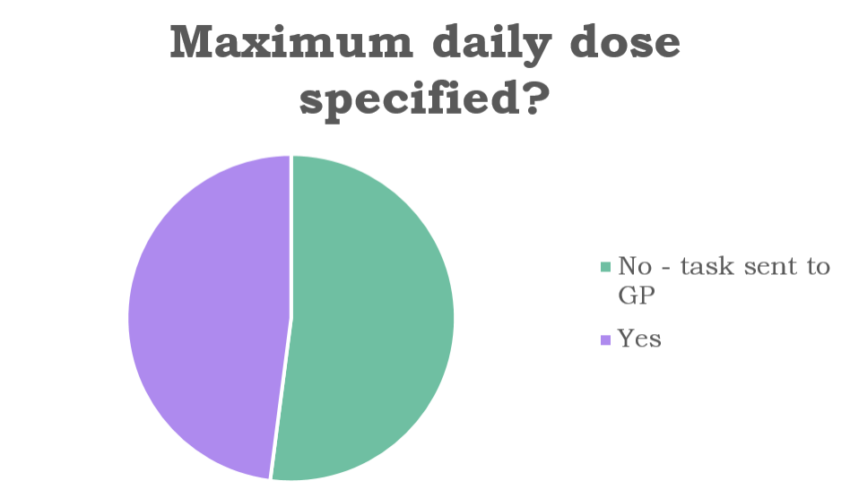
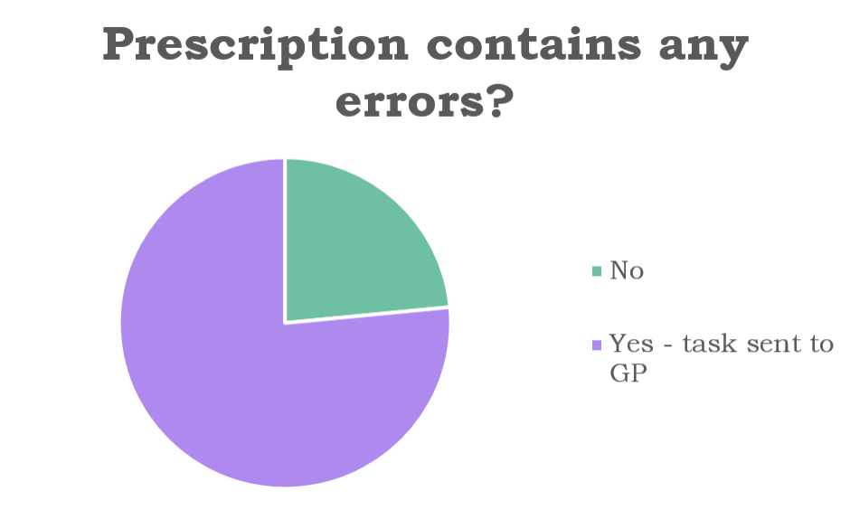
Prescription Errors
38%
33%
62%
67%
23.5%
48%
52%
76.5%

Slide 14
Some Examples of Inappropriate Reasons for a Repeat Oramorph prescription
Sleep
Breathlessness (not a palliative care patient) and also breathing difficulties on exertion post covid
Restless leg
Fractures from many years ago, for example:
A fractured metatarsal in 2017
Sometimes there was never a clear reason

Slide 15
Methods to Improve Oramorph Prescriptions

Slide 16
Proposed EMIS Checklist
Have you specified the dose in both ml and mg? e.g. 2.5ml (5mg)​
Have you specified the dose frequency? E.g. every SIX hours ​
Have you specified the maximum daily dose? E.g. up to FOUR times per day​
Why are you prescribing this medication? Have you checked NICE guidance for treating this condition?​

Slide 17
References
https://www.nice.org.uk/guidance/ng46/evidence/full-guideline-pdf-2427186353
https://bnf.nice.org.uk/drugs/morphine/
https://www.nice.org.uk/guidance/ng193/resources/visual-summary-pdf-9073473517

Slide 18
Thank You

